Slide 1
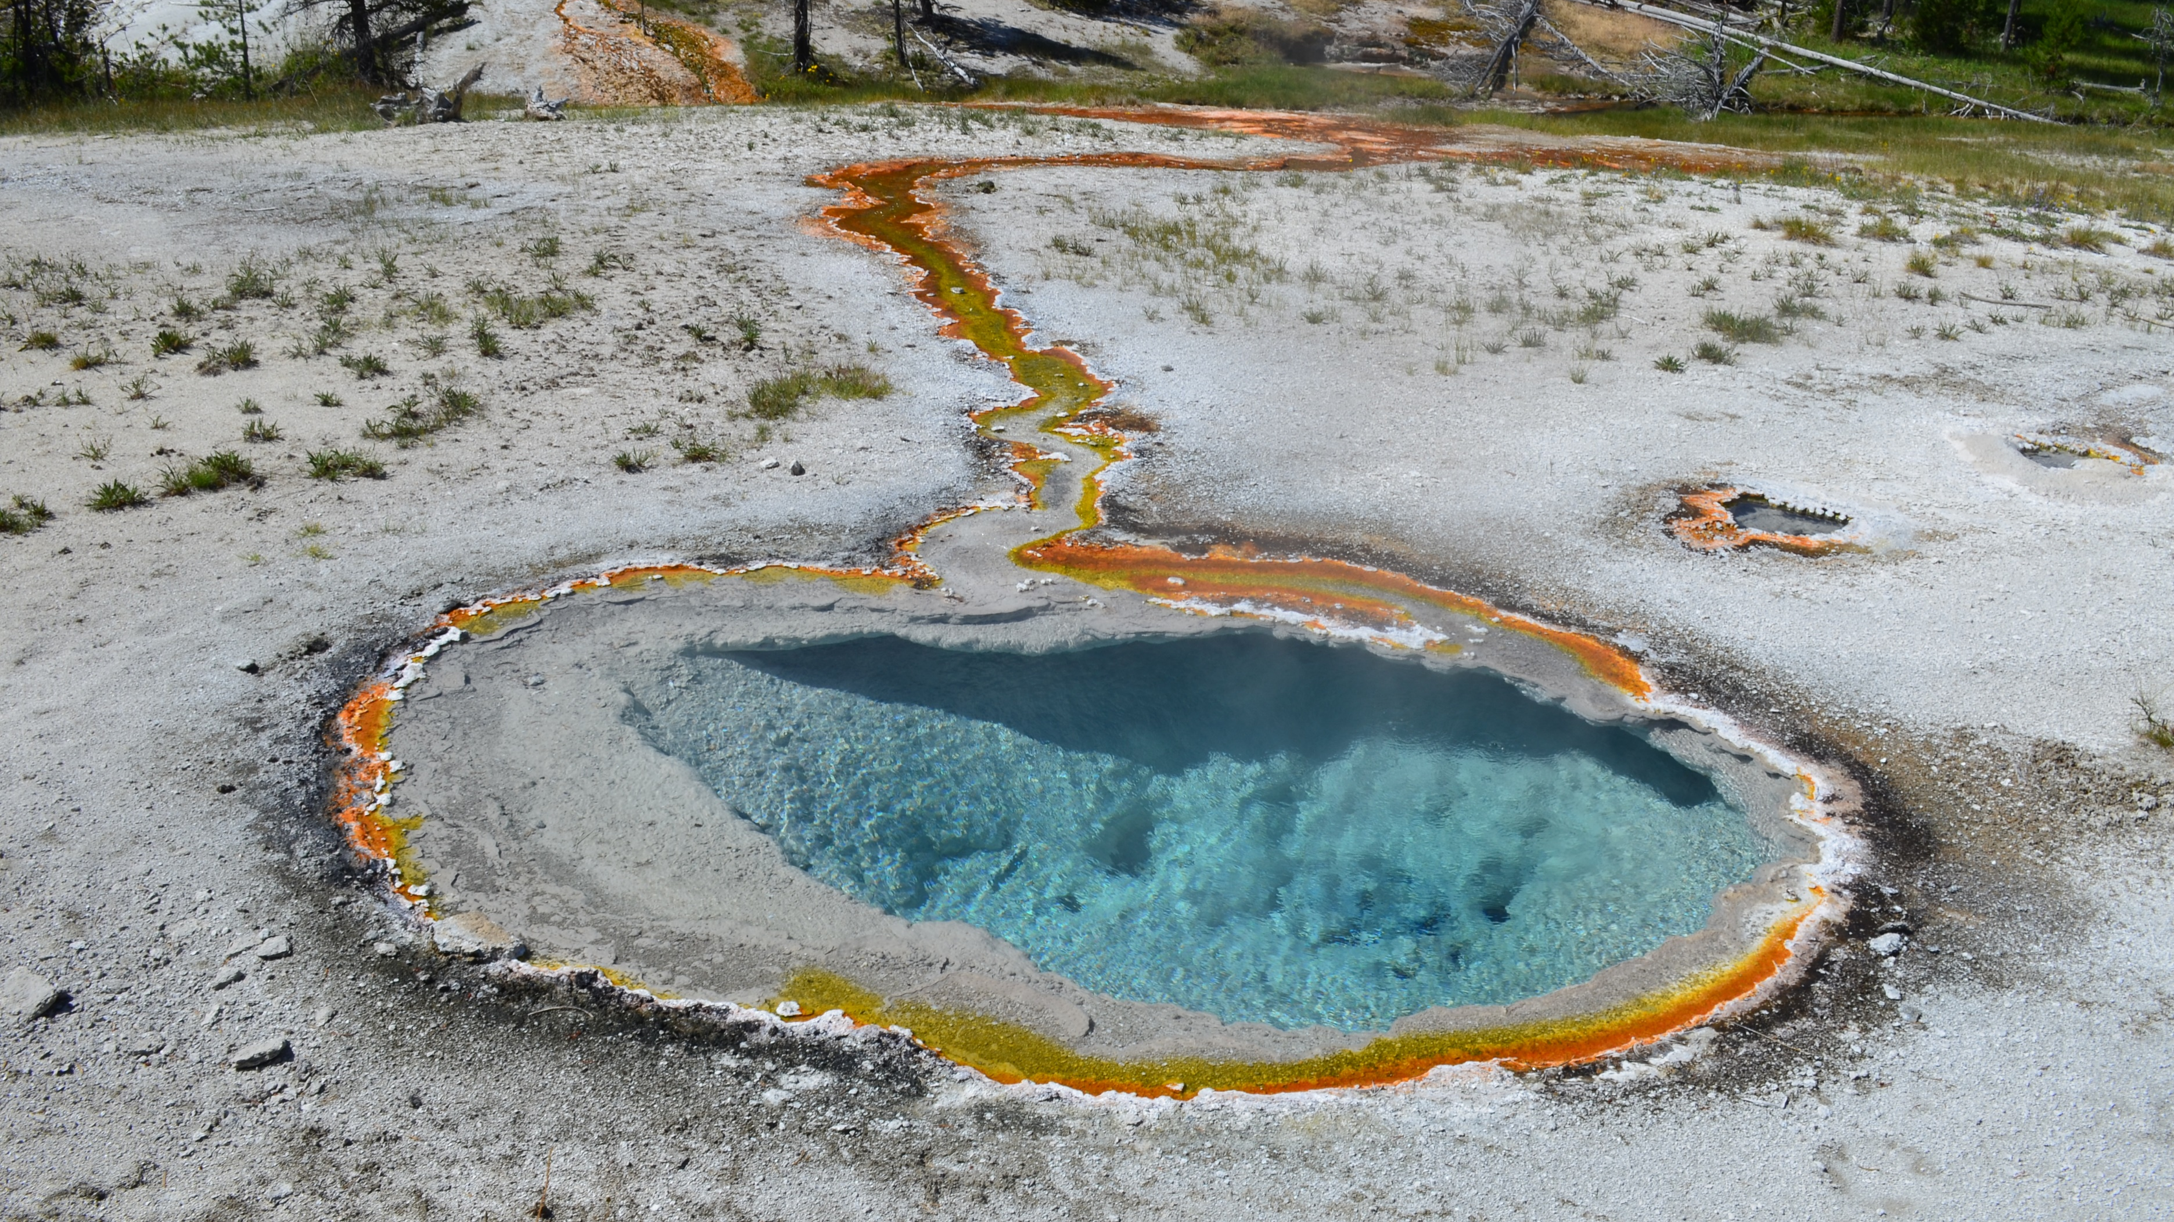
Mapping Solute Concentrations in Outflow Channels
Justin Baez
Dr. Everett Shock
The School of Earth and Space Exploration
Research conducted under Yellowstone Research Permit YELL-2016-SCI-5434

Slide 2
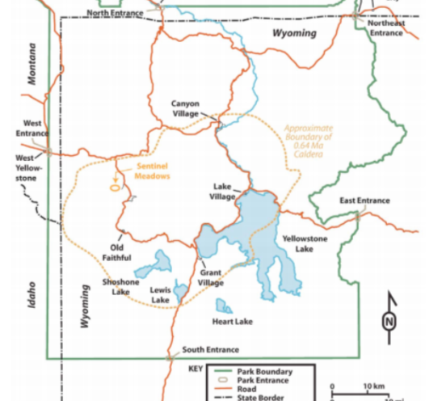
Map of Yellowstone
Yellowstone National Park is mostly contained on the NW Corner of Wyoming.
The location Bison pool, the hot spring of discussion, is within Sentinel Meadows (denoted by the red square).

Slide 3
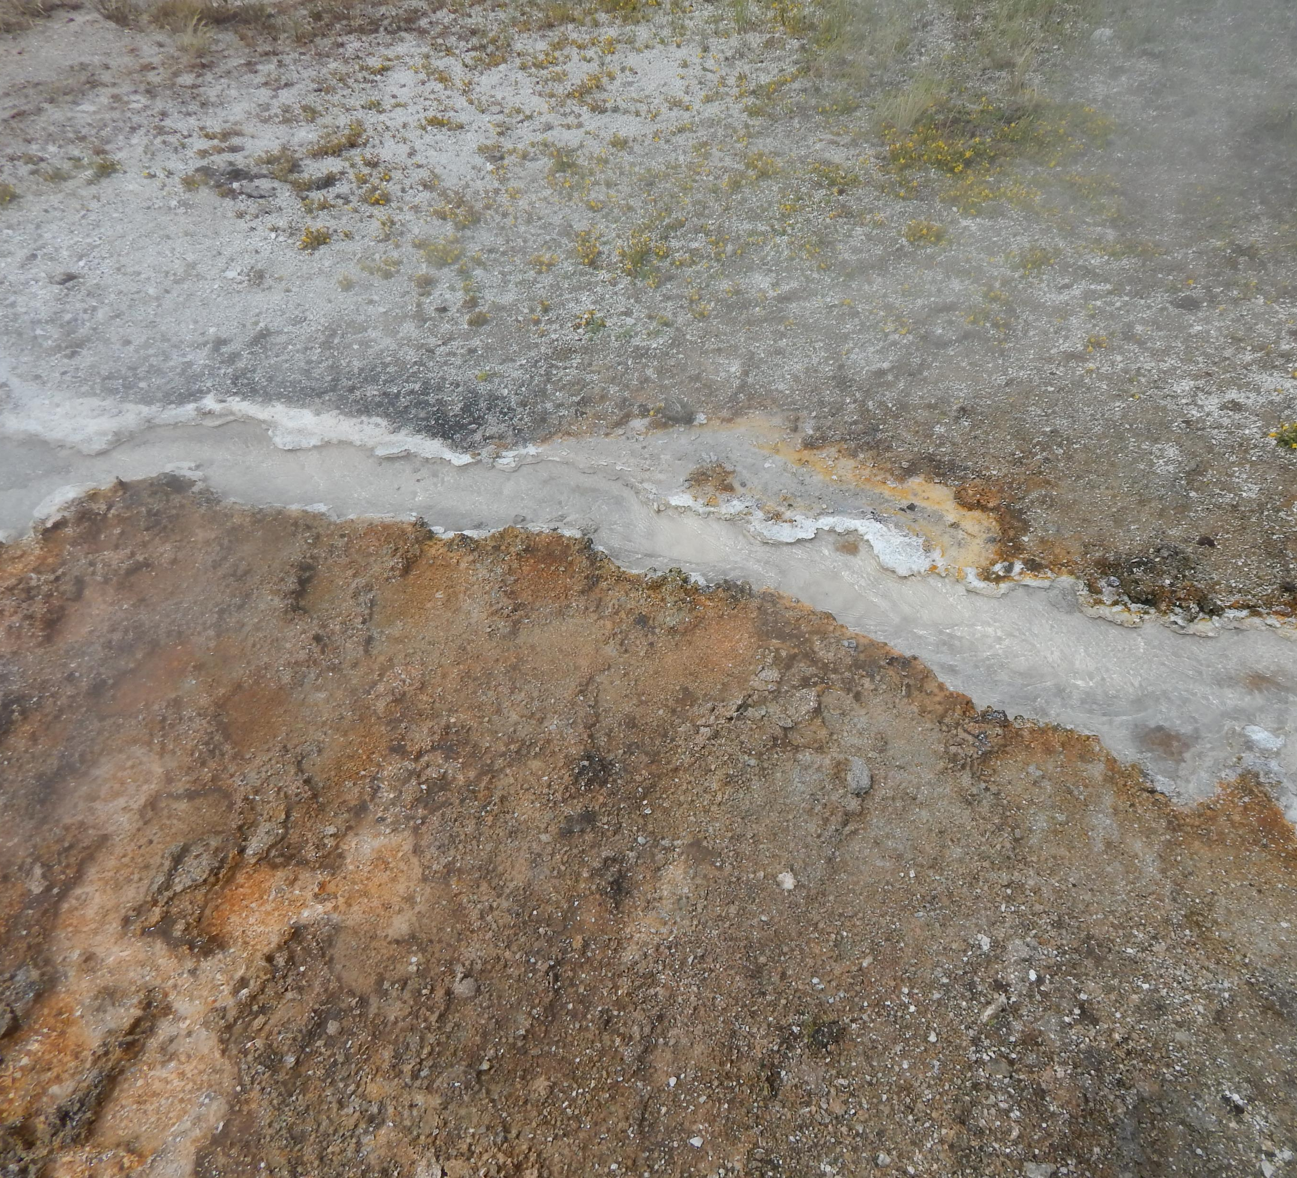
Background
Conservative ions are species that are not commonly taken up by many reactive processes down the outflow channel.
Temperature is used as an indicator of distance from the initial source.
A lower temperature corresponds with a greater distance from source.
Photo by Everett Shock, Research Permit Study # YELL-05434

Slide 4
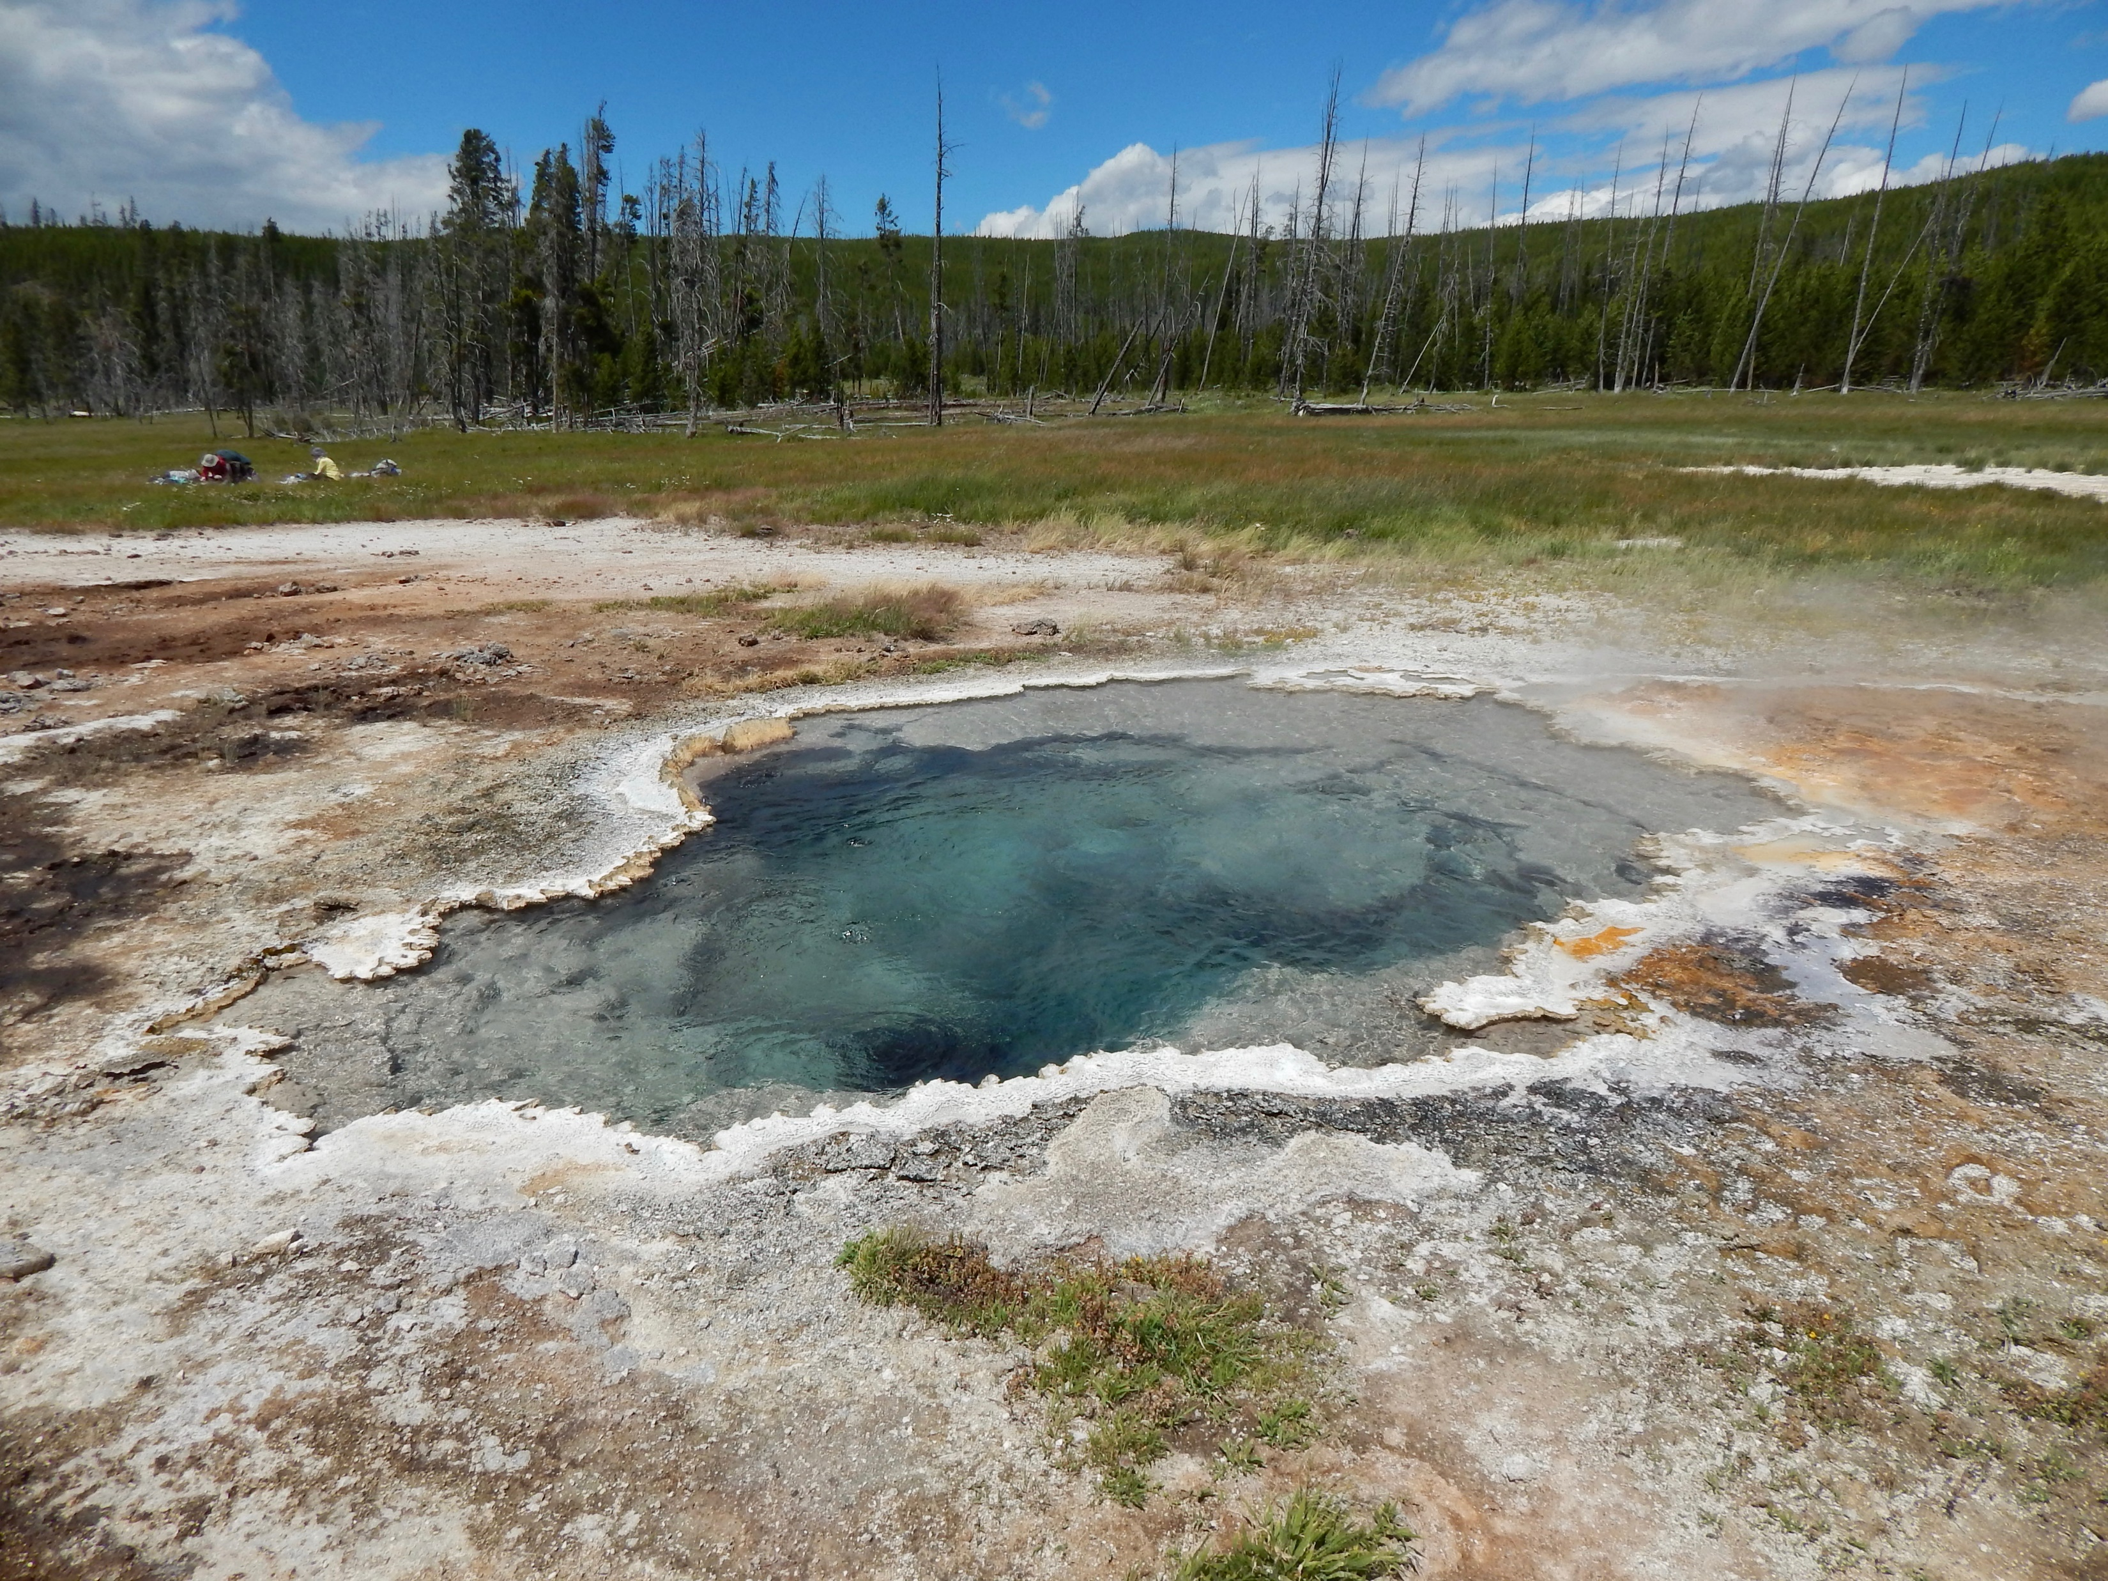
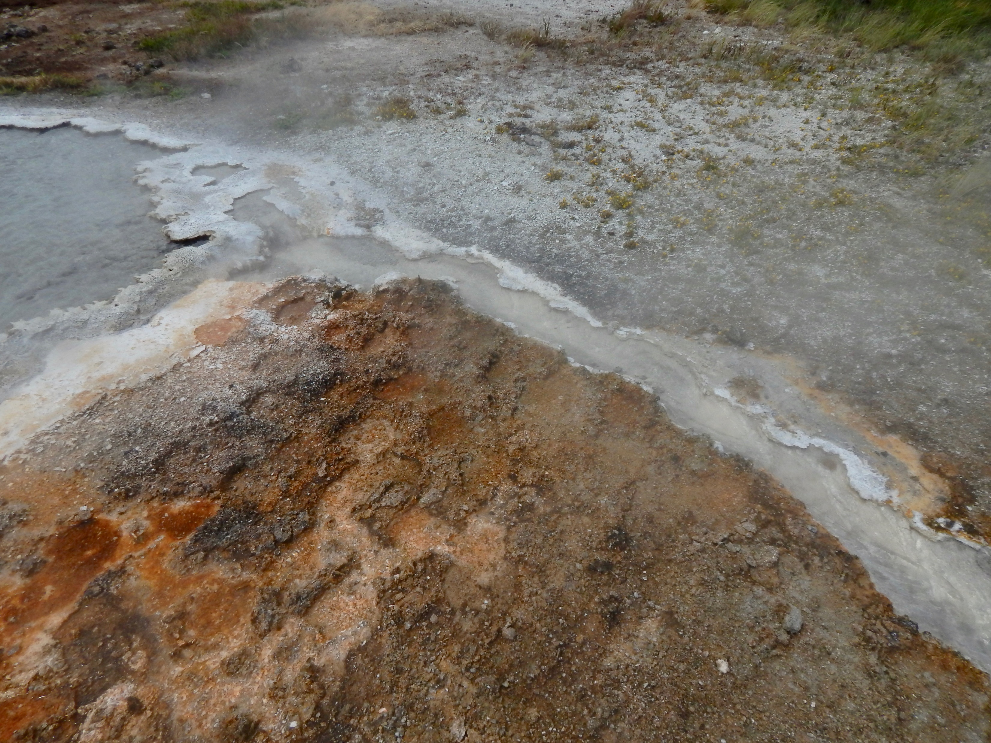
Bison Pool
Photo by Everett Shock, Research Permit Study # YELL-05434
Photo by Everett Shock, Research Permit Study # YELL-05434

Slide 5
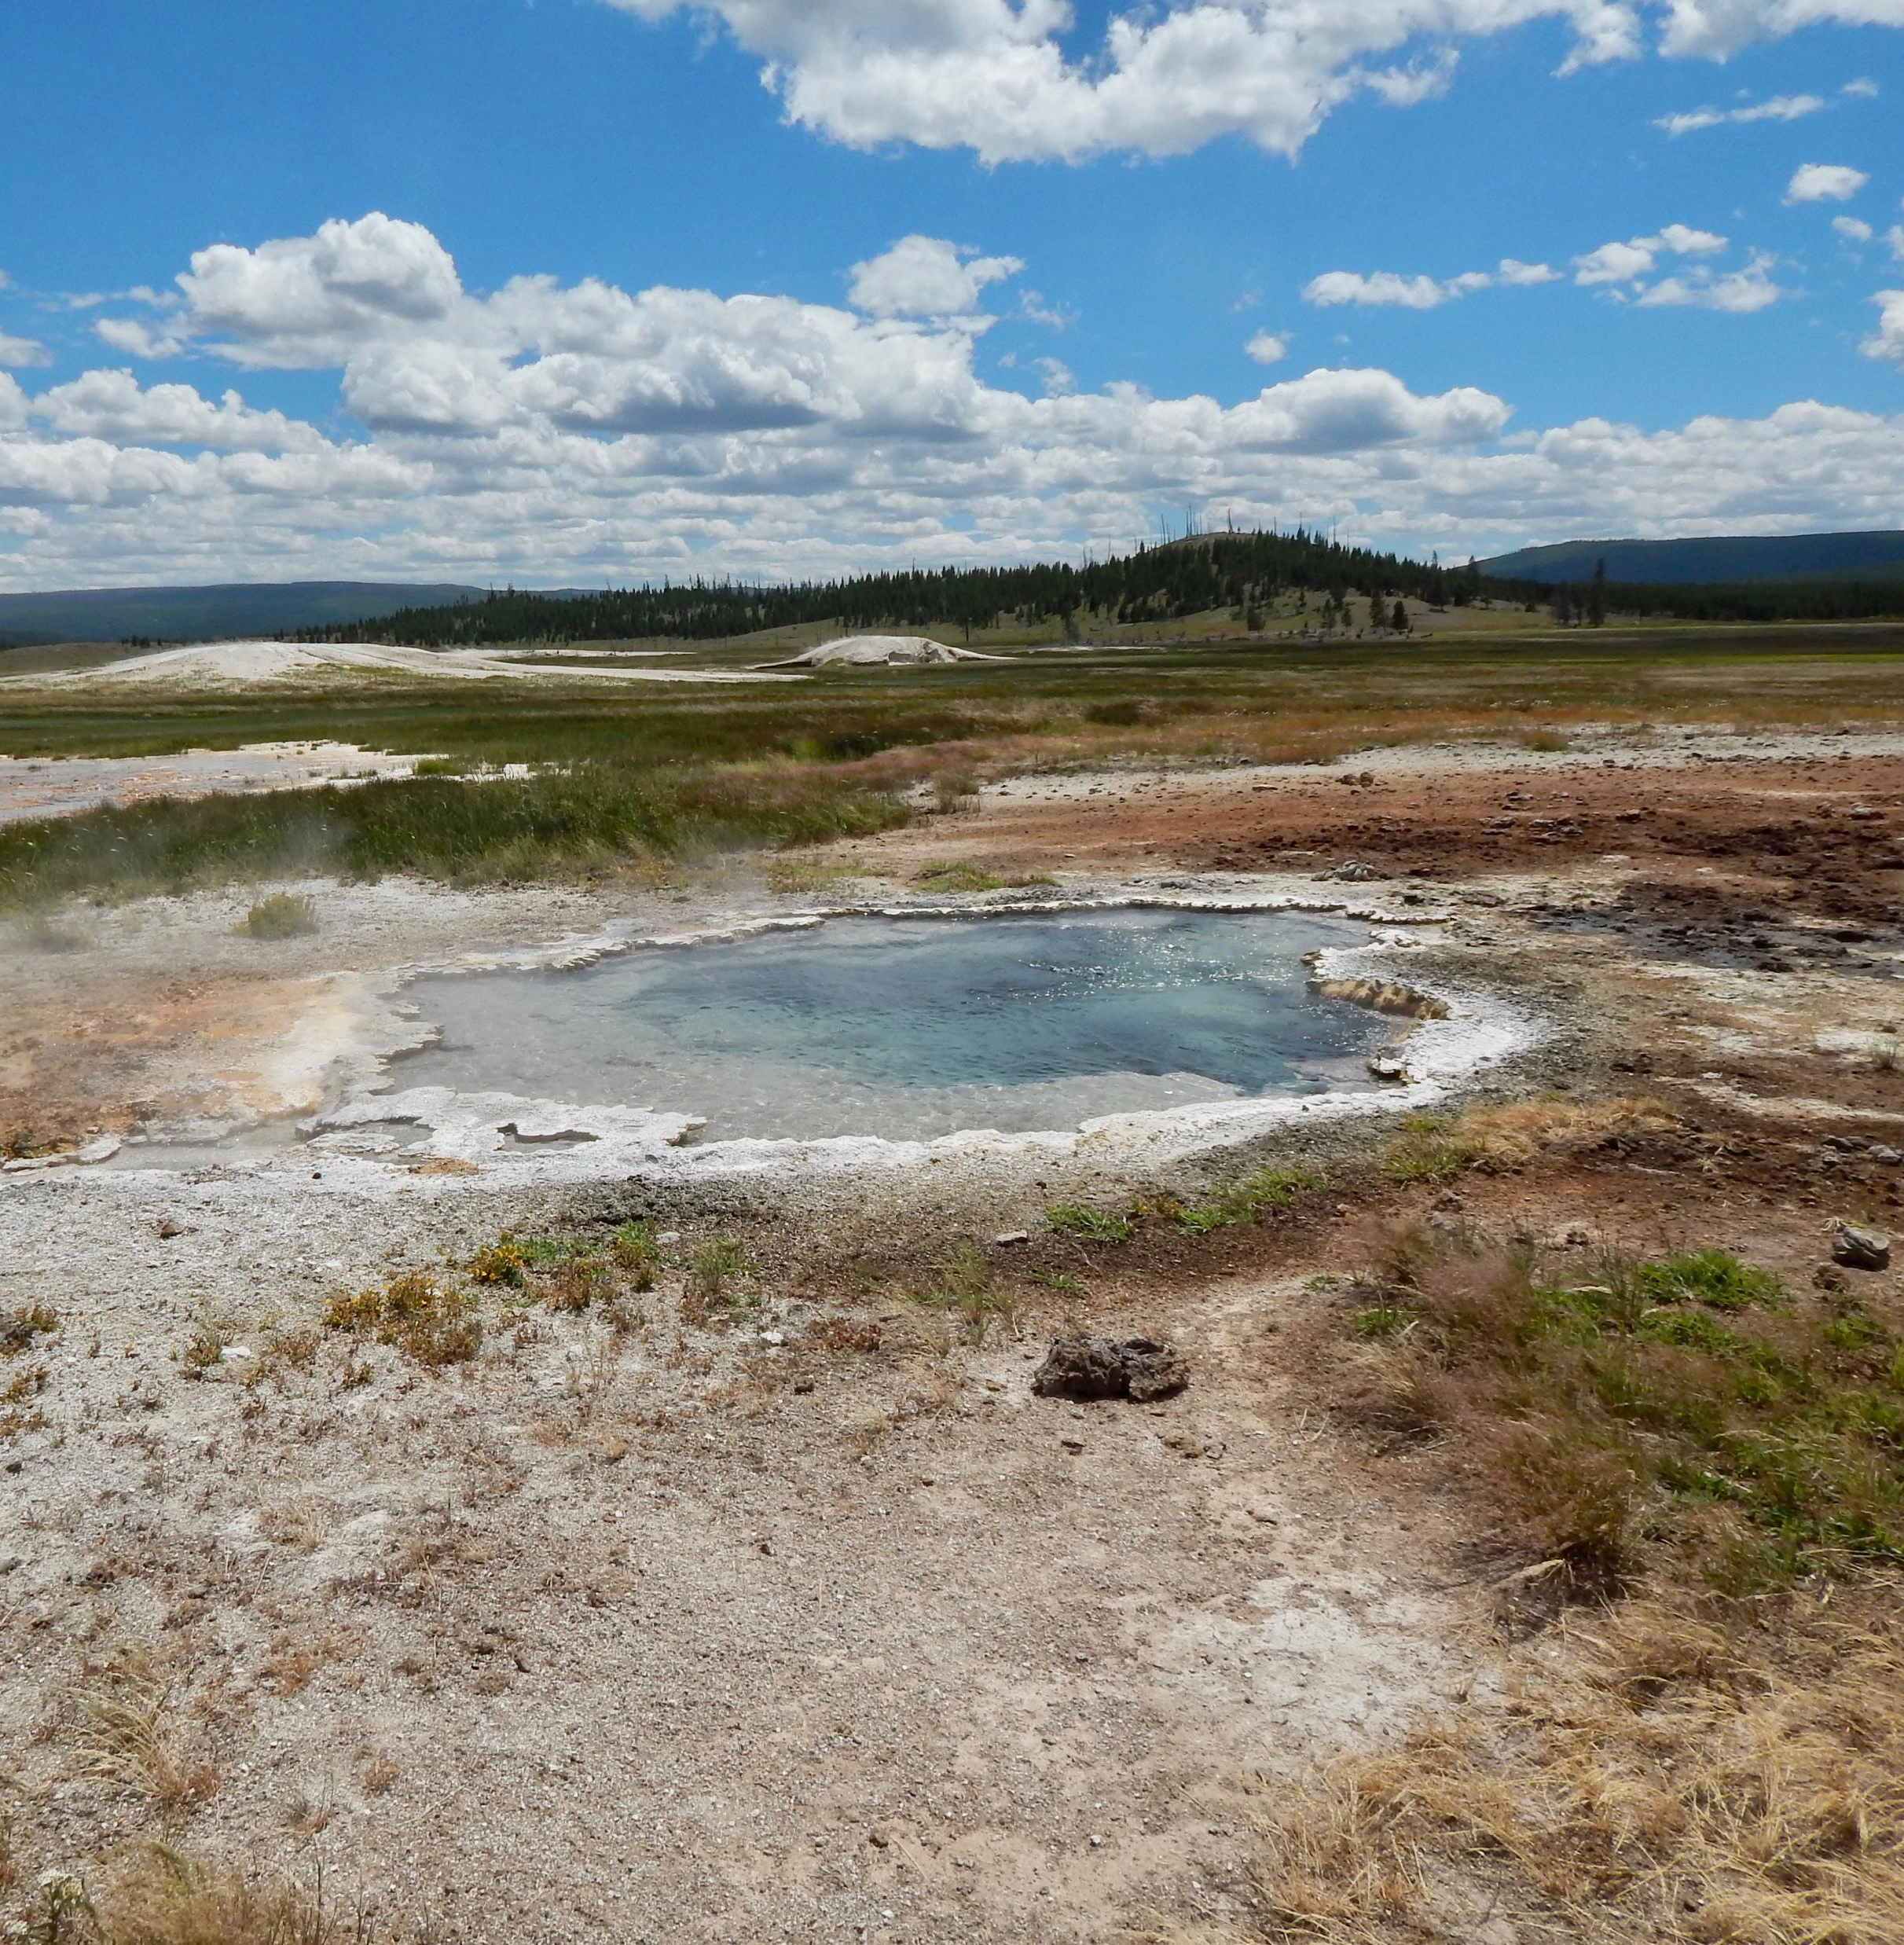
Objectives
To understand the general effects of evaporative processes in outflow Channels.
To predict and interpret the behavior of not so well conserved ions species in the outflow channels using the trends of conserved ion species.
Photo by Everett Shock, Research Permit Study # YELL-05434

Slide 6
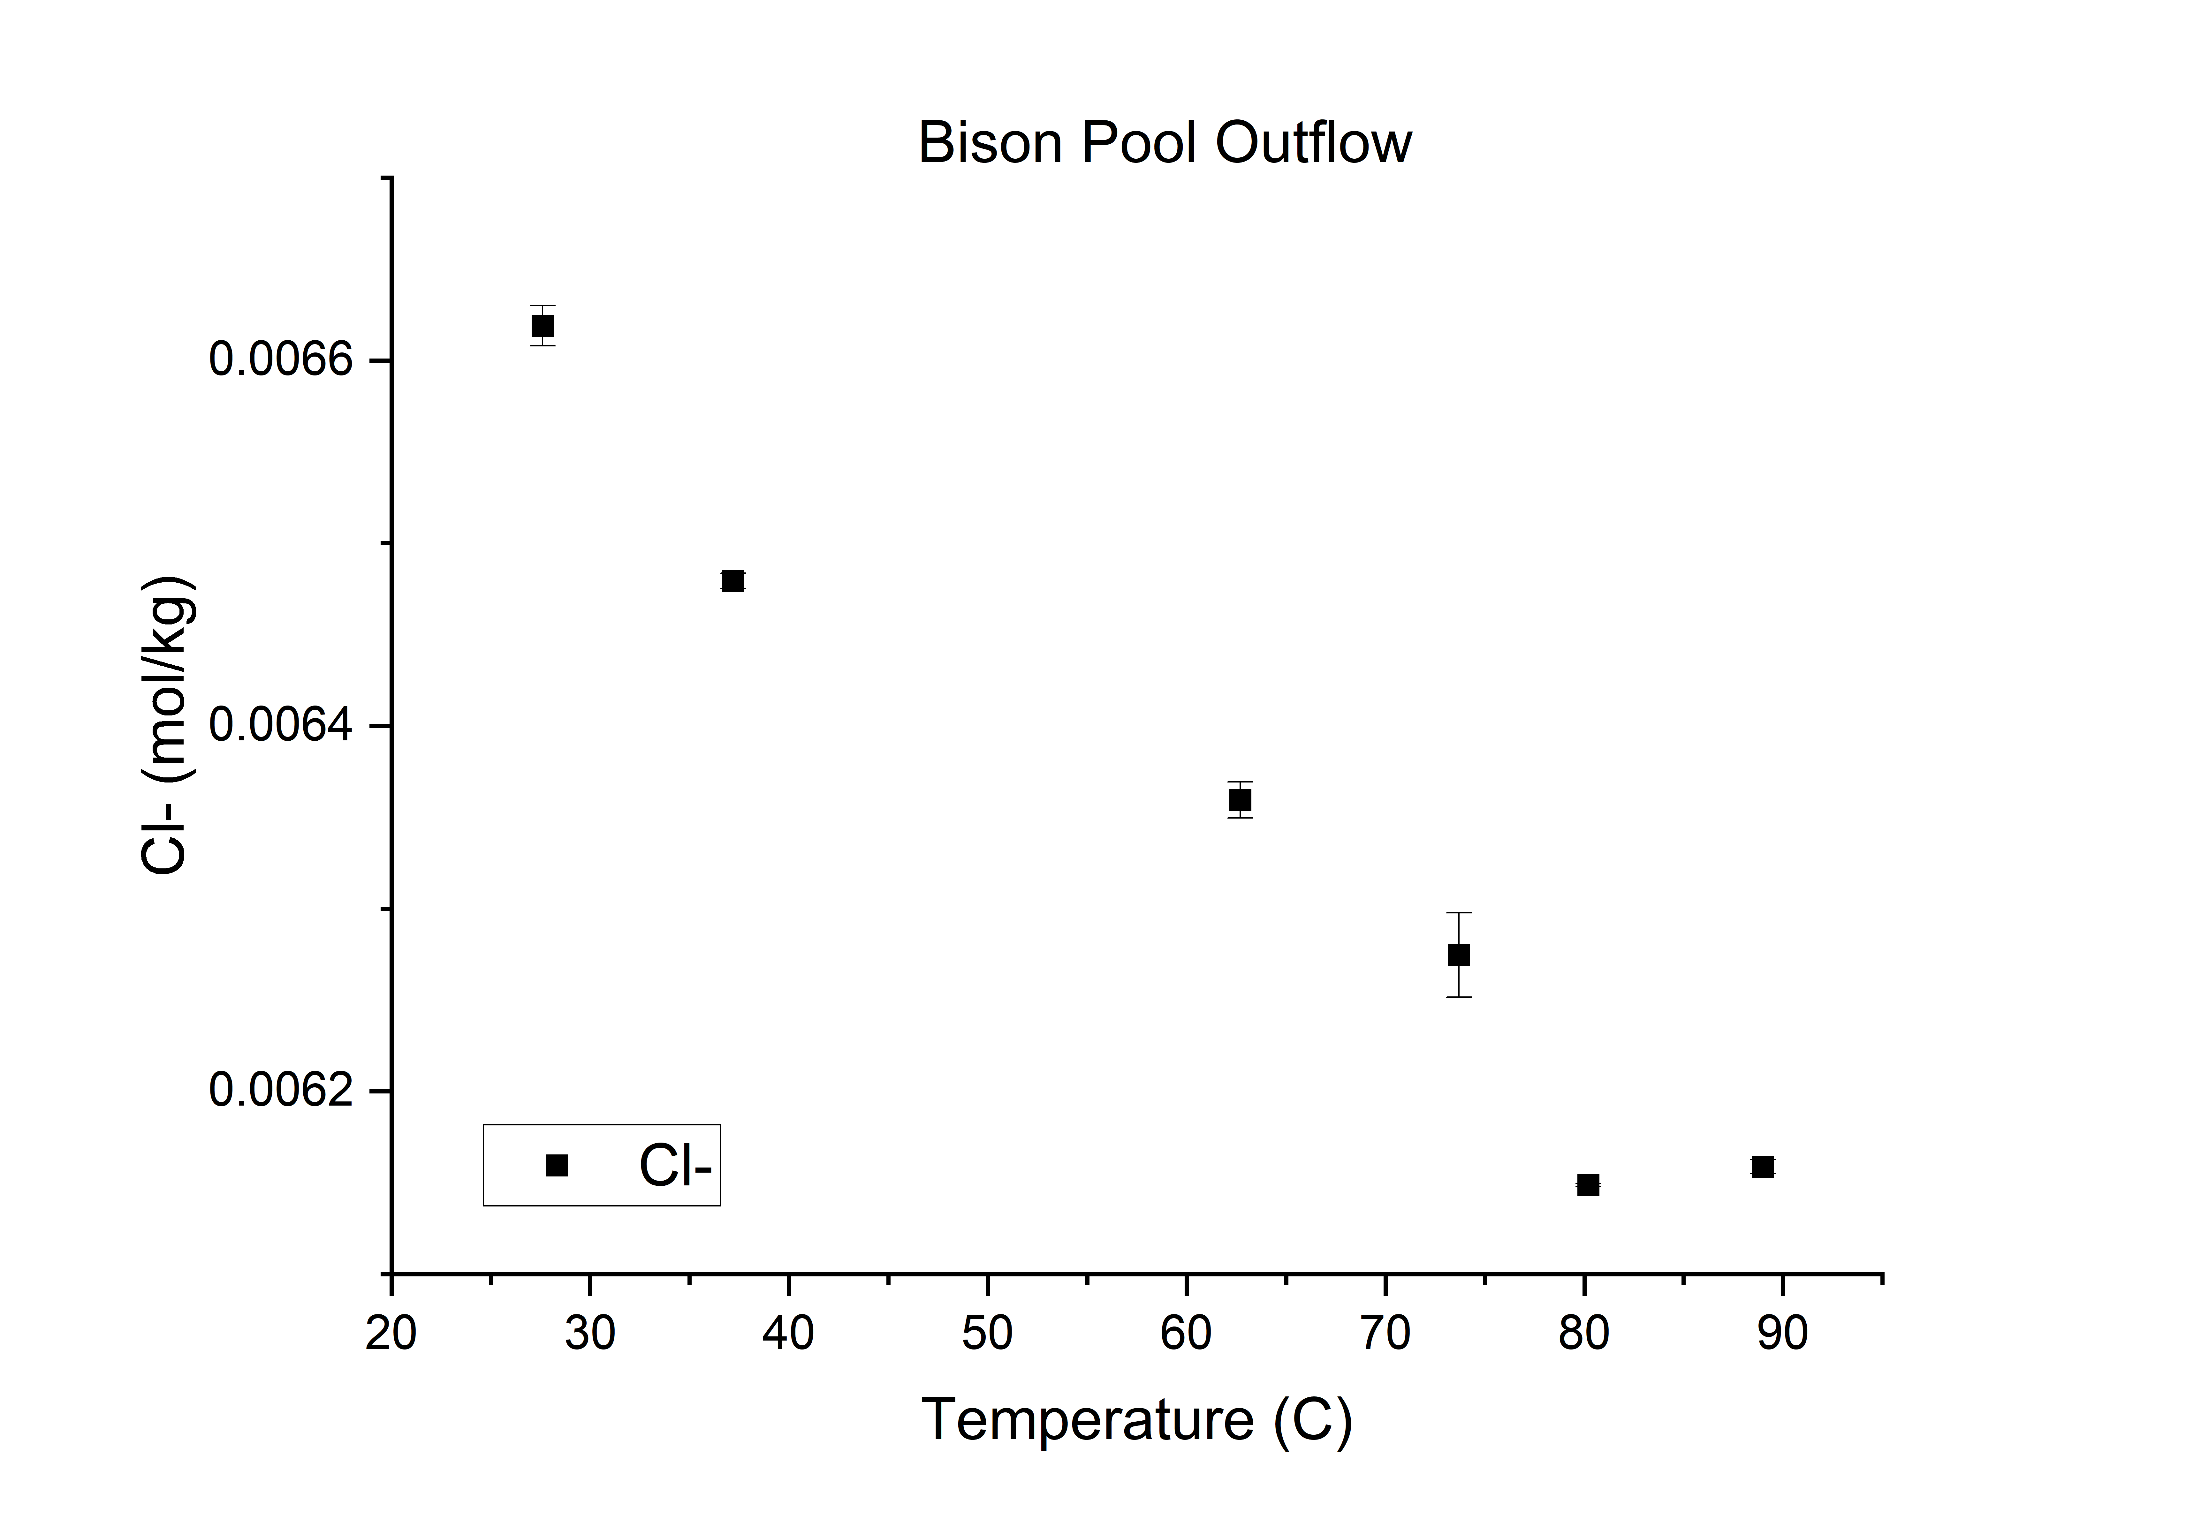
Cl- Evaporative Trend
Chloride Ions (Cl-) remain relatively constant in Outflow channel.
Relative to the available water, the concentration of chloride increases with distance from source.

Slide 7
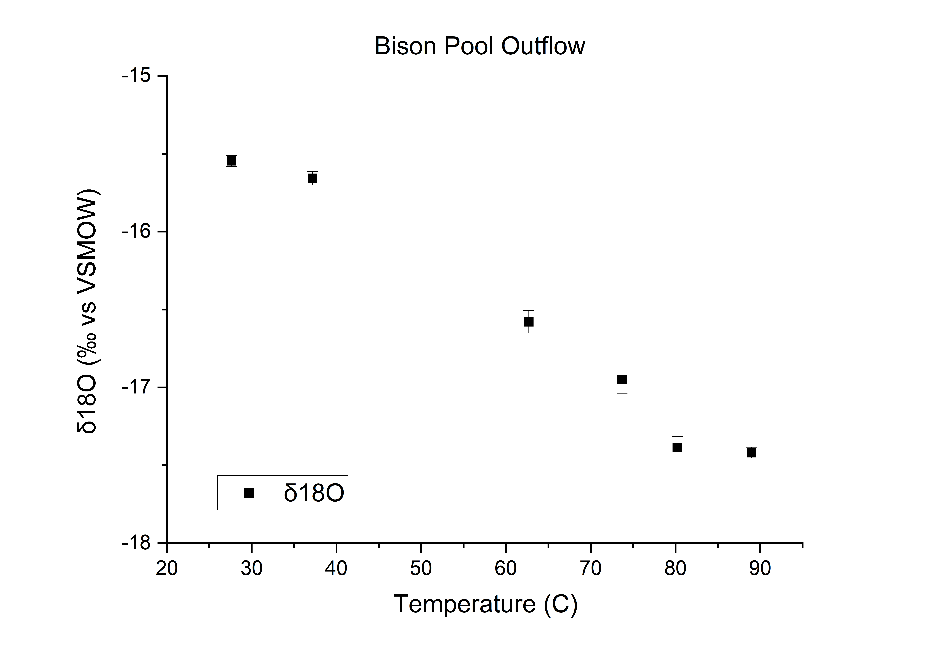
O^18 Evaporative Trend
Oxygen-18 (O^18), a heavier isotope of Oxygen is more sensitive than Cl- to evaporative processes.
Relative to lighter alternative isotopes of Oxygen, concentration of O^18 increases with distance from initial source.

Slide 8
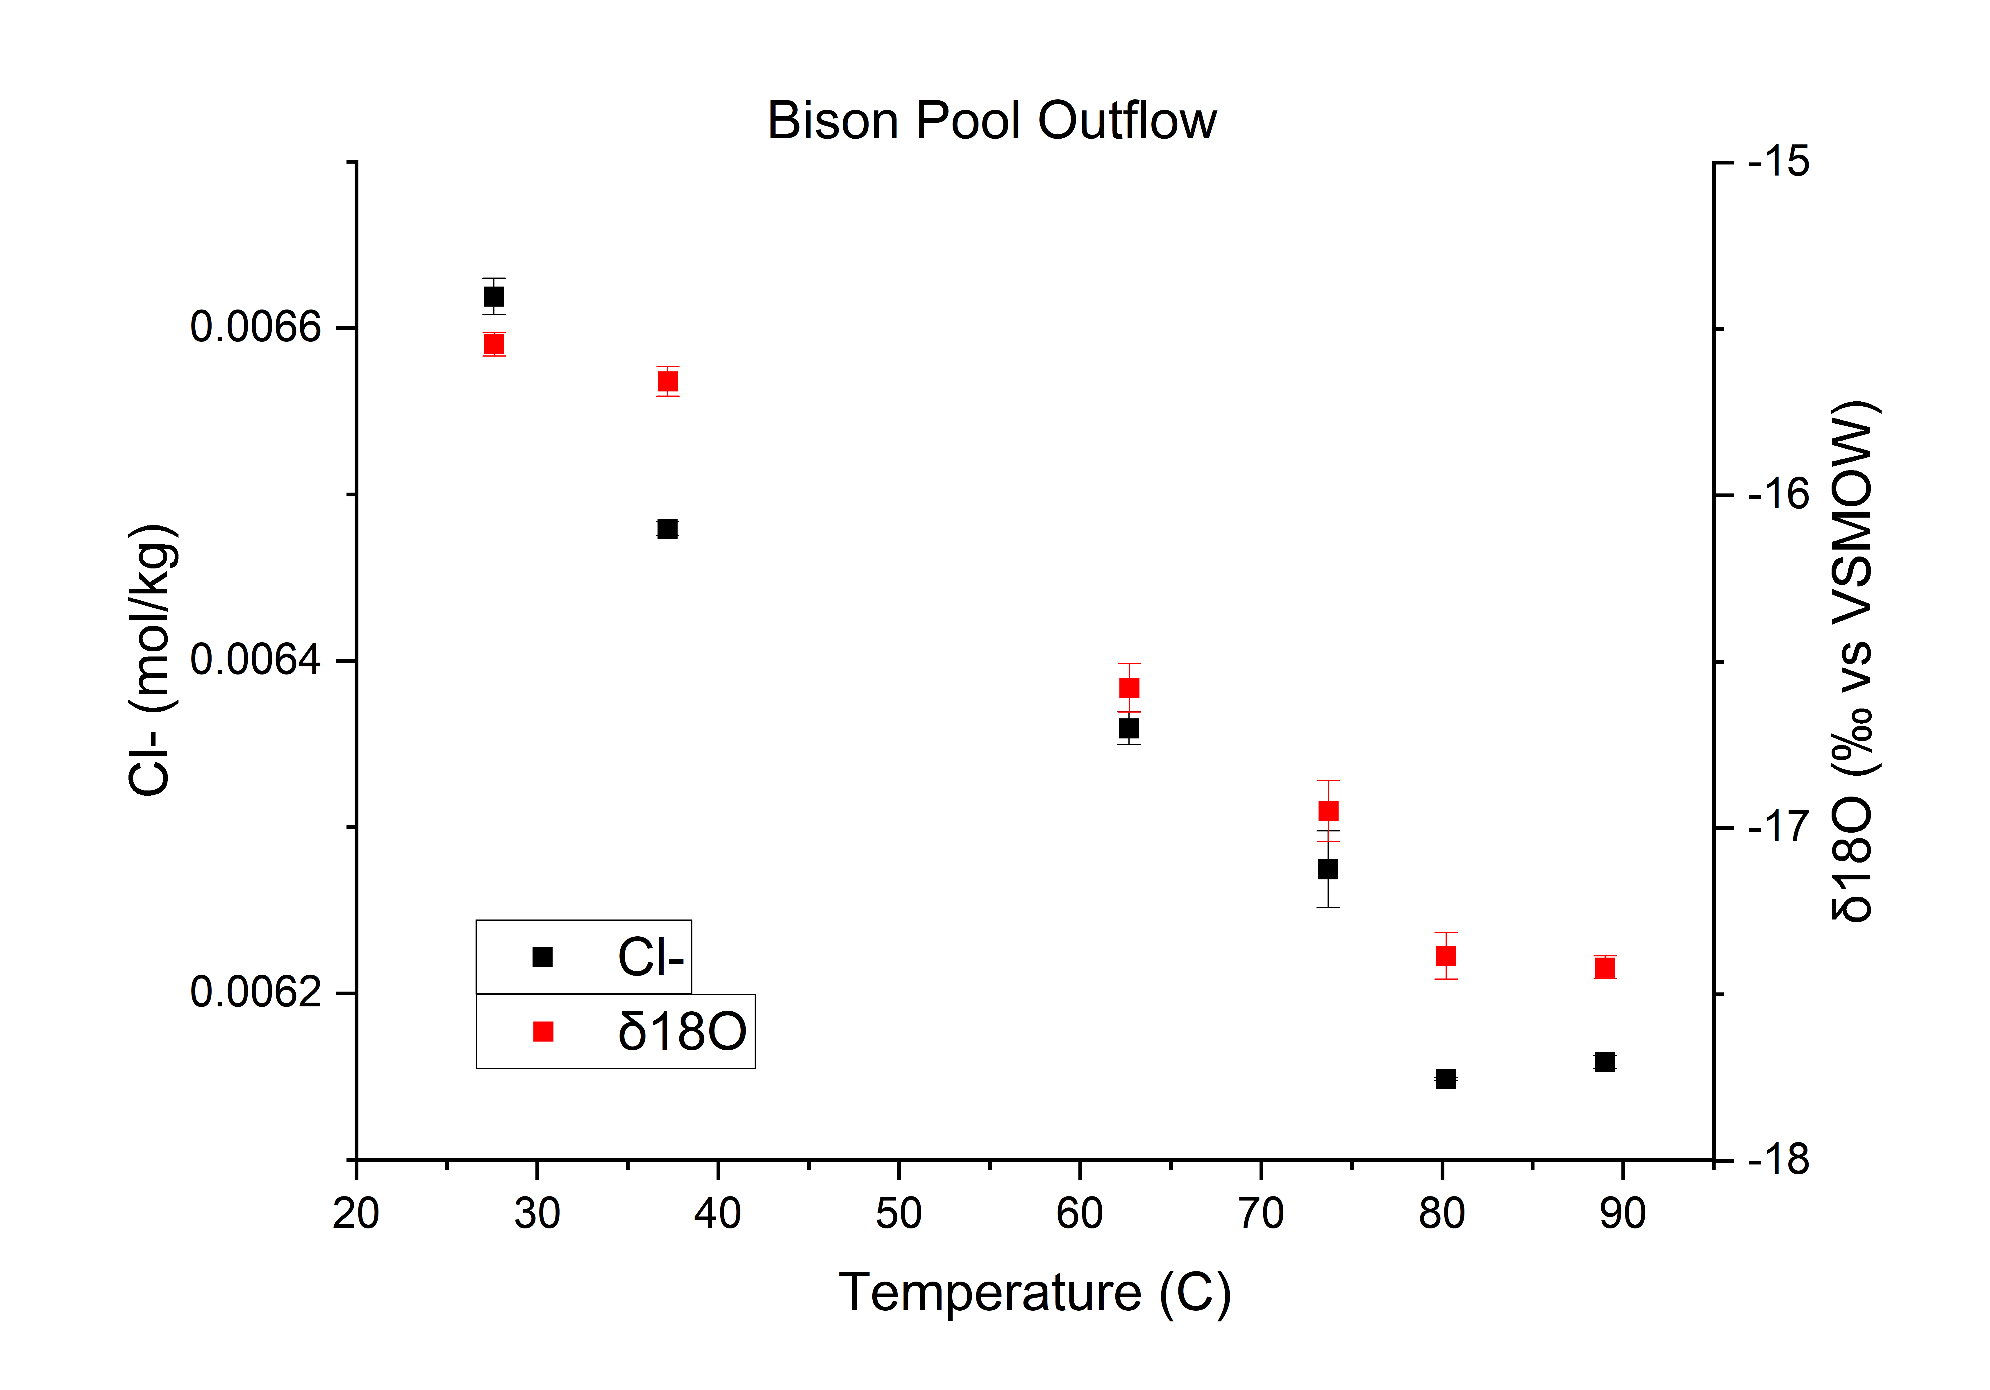
Summary of Evaporative Effects
Based on the evaporative trends of the conservative species, concentration generally tends to increase with distance from Initial Source.
Using the slopes/trends of the conservative species, projected tends can be made to produce a base for understanding the trends of other solutes in solution.

Slide 9
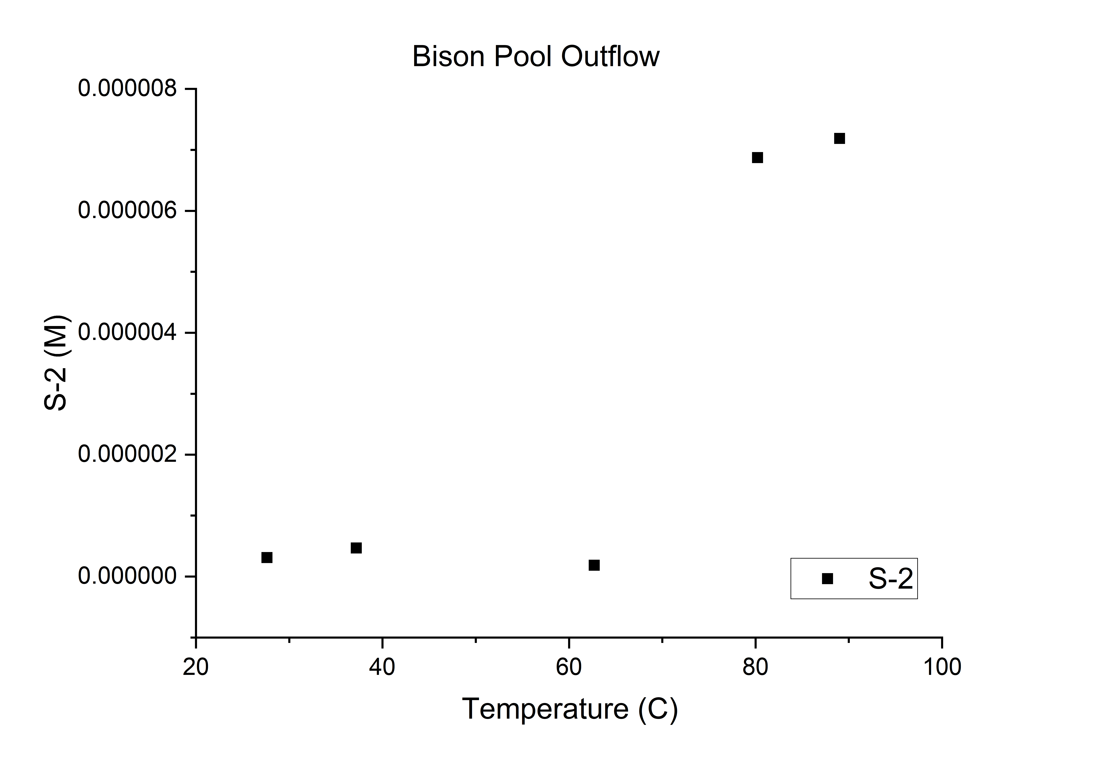
Sulfide Evaporation
Within a similar temperature range, sulfide exhibits an opposite trend to the conservative species.
…What’s going on?

Slide 10
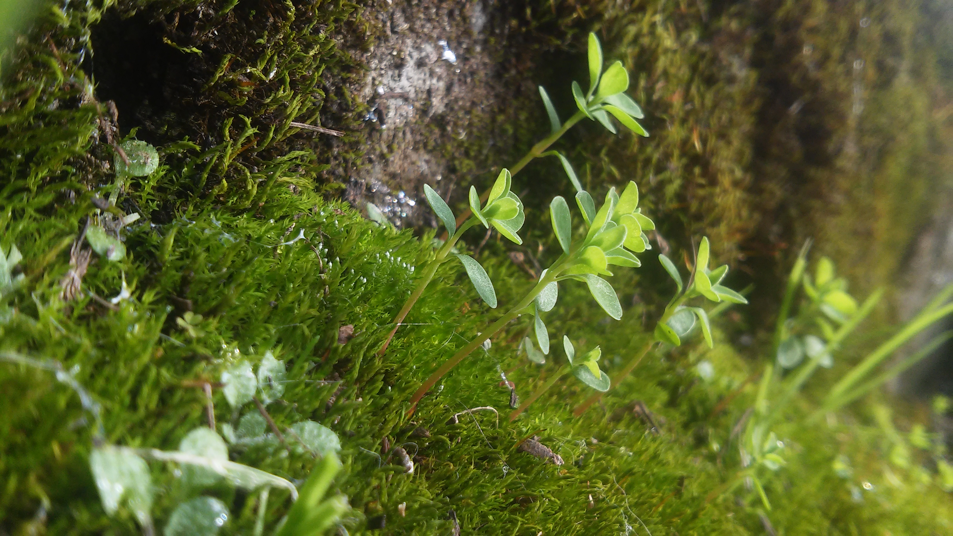
Possible Indications of Life

Slide 11
Acknowledgments
Special Thanks to:
Dr. Everett L. Shock.
R. Vincent Debes II,
Alta Howells,
James A. Leong,
GEOPIG Research Team
NASA Space Grant
The School of Earth and Space Exploration (ASU)

Slide 12
Sources
1) Having, J.R., J. Raymond, D.R. Meyer-Dombard, N. Zolotova, E.L. Shock (2011), Merging isotopes and community genomics in a siliceous sinter‐depositing hot spring, Journal of Geophysical Research, Vol.116.

